Slide 1
POJECT TITLE Creating an sponsored post for Instagram

Slide 2
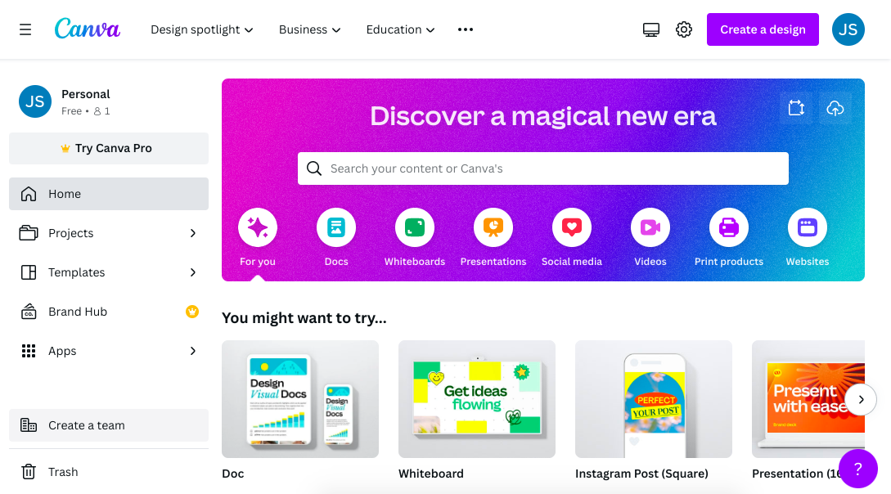
1)Open canva, click on get started

Slide 3
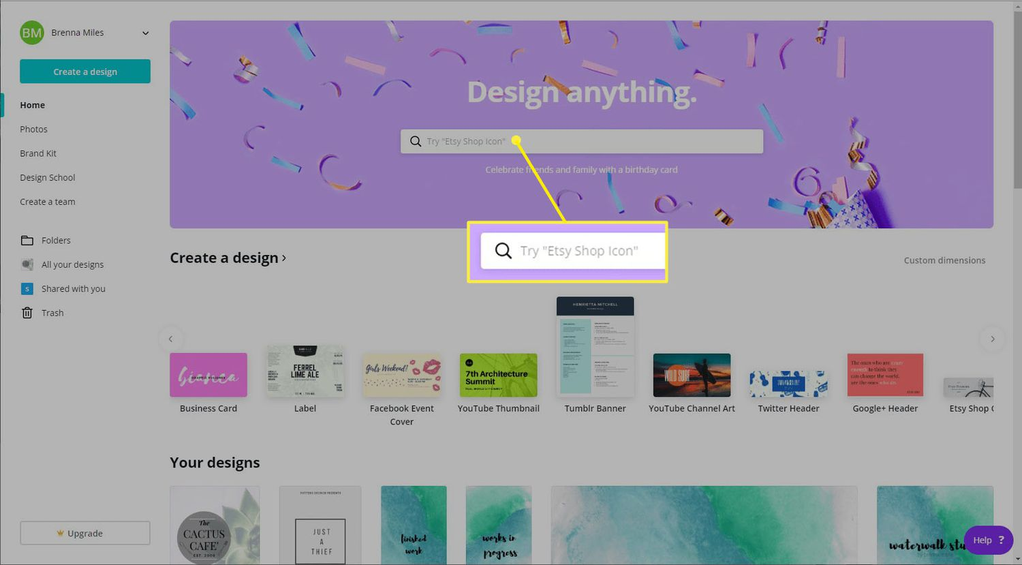
2)Choose any format and design

Slide 4
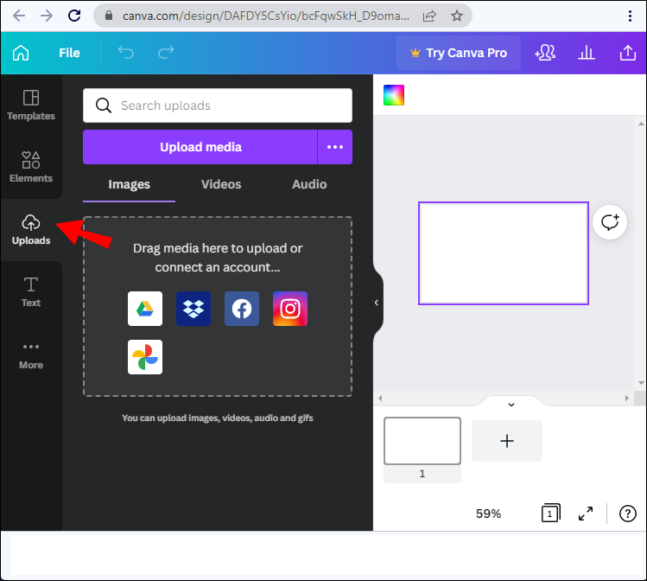
3)Upload the logo

Slide 5
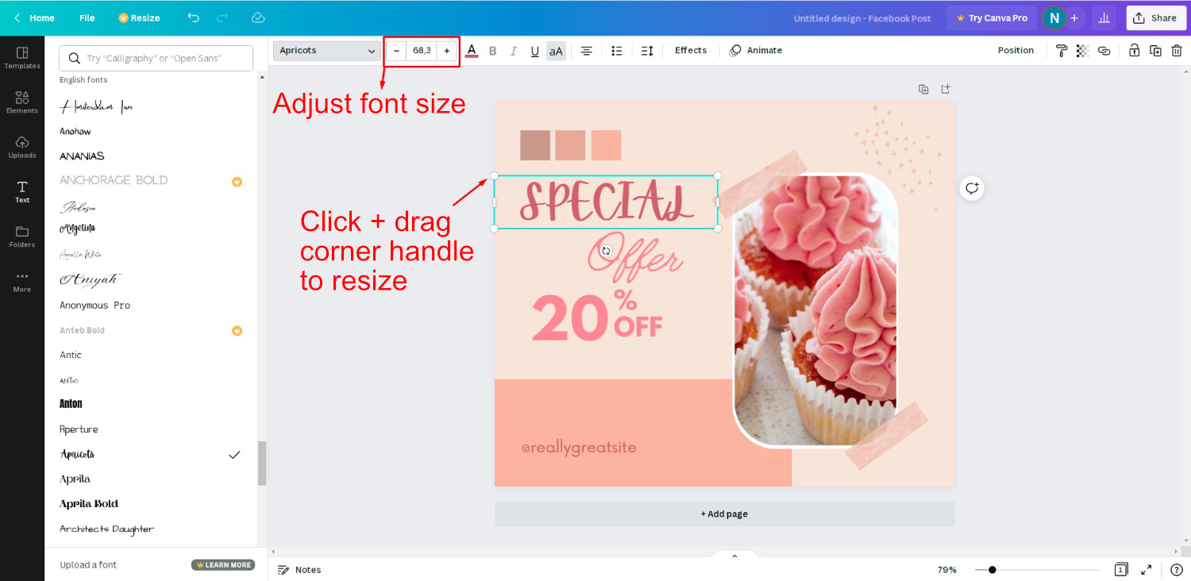
4)Resize the logo and edit the text contents

Slide 6
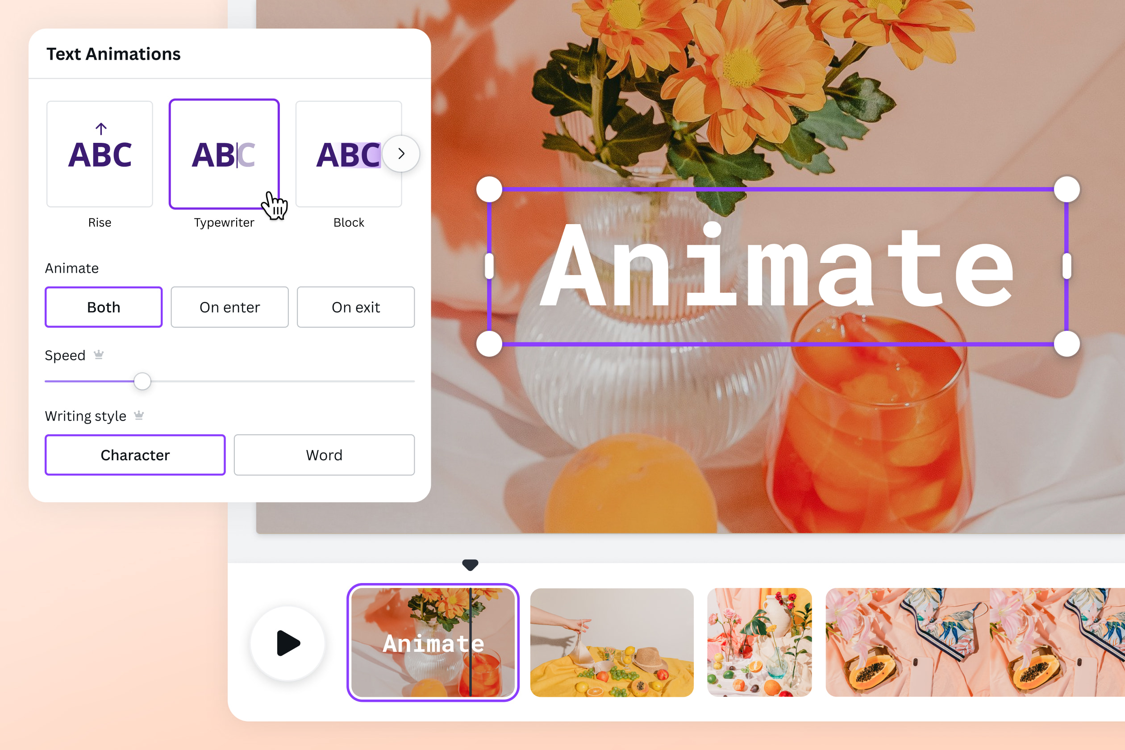
5)Add text effects and graphics

Slide 7
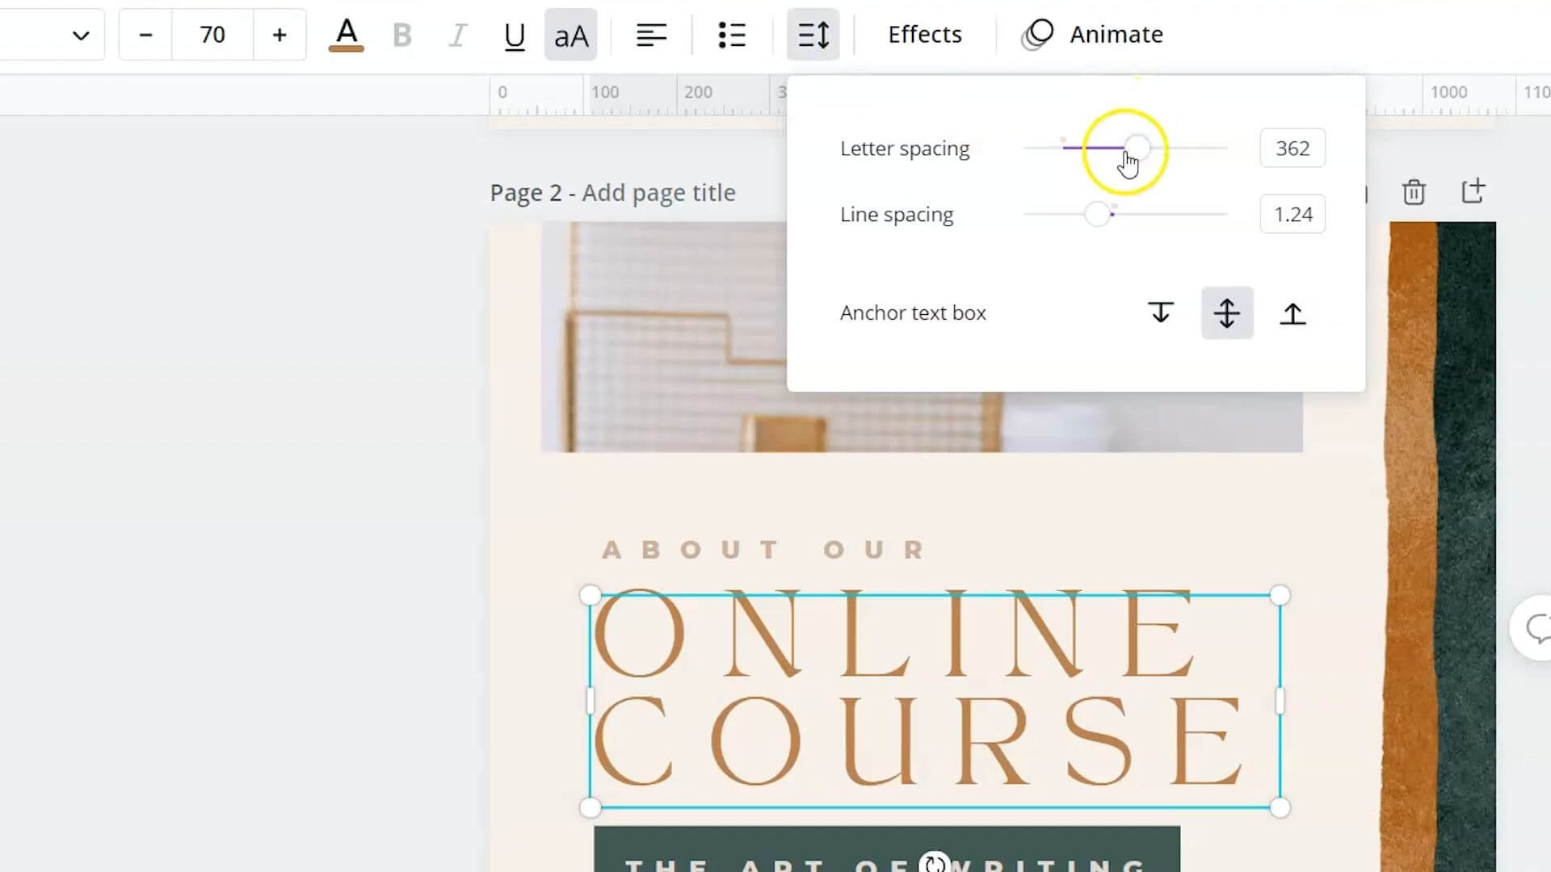
6)Adjust letter spacing & line spacing

Slide 8
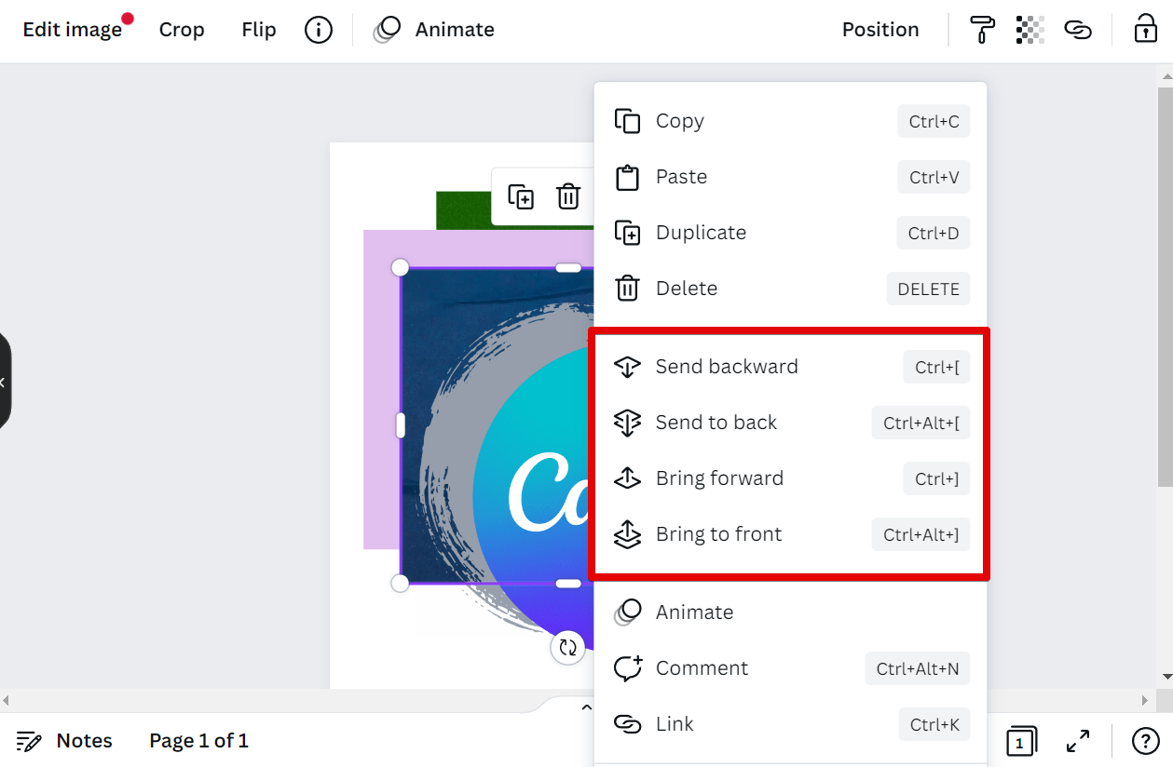
7)Edit the layers and other elements

Slide 9
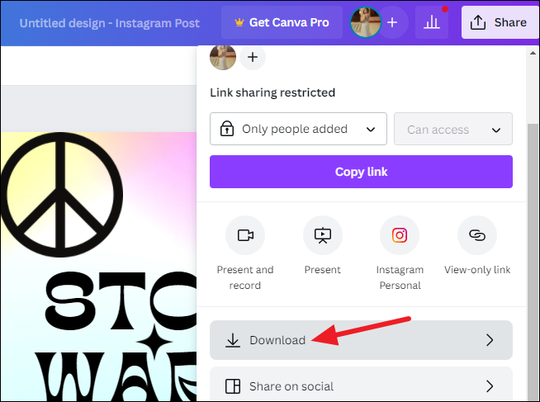
8)Now click download

Slide 10
Demo video link: https://youtu.be/EWC2NeKYFsM?si=DfVpv9-AWw9QH9n2
Instagram post link:
https://www.instagram.com/p/Cym8NYNprBz/?igshid=NjIwNzIyMDk2Mg==

